Slide 1
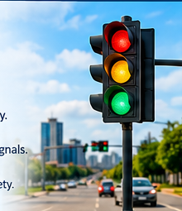
Real-Time Operating System
(RTOS) in Traffic Signal Control
Presented by :
Ezhilarasi B
192521428

Slide 2
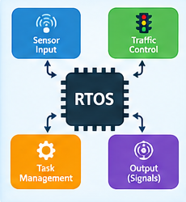
Introduction to RTOS
1. RTOS provides predictable and timely responses.
2. It manages multiple tasks efficiently.
3. It processes sensor inputs from roads.
4. It controls traffic signals at the correct time.
5. It supports reliable and continuous operation.
RTOS CONTROLLER
Sensors
Traffic
Lights
Task
Manager
Timer

Slide 3

Type of OS and Justification
1. A Real-Time Operating System (RTOS) is suitable for traffic control.
2. It provides predictable response times.
3. It supports priority-based task scheduling.
4. It handles emergency vehicle signals quickly.
5. It reduces delays and improves traffic management.
Why RTOS?
Predictable timing
Priority scheduling
Fast event response

Slide 4
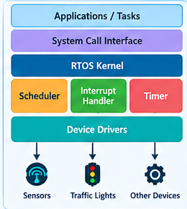
OS Structure and Components
1. Kernel: Manages system resources and tasks.
2. Scheduler: Selects which task runs next.
3. Interrupt Handler: Responds to sensor signals.
4. Device Drivers: Control traffic lights and sensors.
5. Timer: Maintains accurate signal durations.
Applications / Tasks
System Call Interface
RTOS Kernel
Scheduler
Interrupt
Handler
Timer
Device Drivers

Slide 5
System Calls for Process Control
1. task_create() – Creates a new task.
2. task_delete() – Deletes a task.
3. task_suspend() – Temporarily pauses a task.
4. task_resume() – Restarts a suspended task.
5. task_yield() – Allows another ready task to run.
TASK CONTROL
Create
Delete
Suspend
Resume
Yield
Note: Names vary by RTOS.

Slide 6

Timing System Calls and Applications
1. sleep() – Delays a task for a specified time.
2. timer_create() – Creates a timer.
3. timer_start() – Starts the timer.
4. clock_gettime() – Reads the system clock.
5. delay_until() – Schedules a task at a specific time.
TIMING FUNCTIONS
sleep()
timer_create()
timer_start()
clock_gettime()
delay_until()
Note: Exact API names depend on the RTOS.

Slide 7

Thank You

